Slide 1
Open/Closed Principle

Slide 2
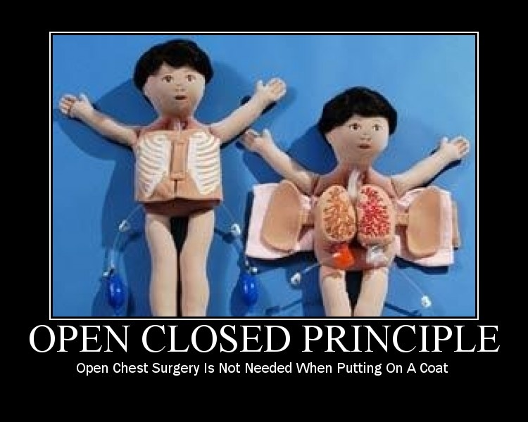

Slide 3
Open/Closed Principle
“software entities (classes, functions, etc.) should be open for extension, but closed for modification”

Slide 4
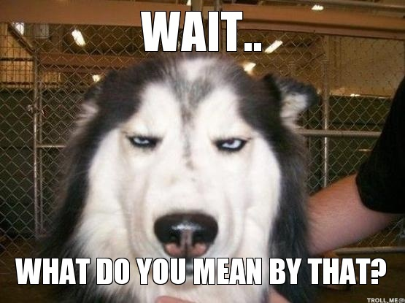

Slide 5

Protected Variation
« I immediately took a dislike to both of these descriptions. Both of them specifically say that the source code can’t be changed, and the description of Meyer’s approach to "make a change by extending a class" feels like a ghastly abuse of inheritance to me… and goes firmly against my (continued) belief in Josh Bloch’s advice of "design for inheritance or prohibit it" – where in the majority of cases, designing a class for inheritance involves an awful lot of work for little gain. Designing an interface (or pure abstract class) still involves work, but with fewer restrictions and risks. », Jon Skeet
https://codeblog.jonskeet.uk/2013/03/15/the-open-closed-principle-in-review/

Slide 6
Protected Variation
« Identify points of predicted variation and create a stable interface around them. », Jon Skeet
https://codeblog.jonskeet.uk/2013/03/15/the-open-closed-principle-in-review/

Slide 7
Protected Variation
«Of course, the costs of incorrectly predicting variation can be high: if you predict more variation than is actually warranted, you waste effort on over-engineering. If you predict less variation than is required, you usually end up either having to change quite a lot of code (if it’s all under your control) or having to come up with an "extended" interface. », Jon Skeet
https://codeblog.jonskeet.uk/2013/03/15/the-open-closed-principle-in-review/

Slide 8
Démo

